Slide 1

Data Science at UBER
Marketing Analytics
Vaibhav Vishal
Louis d'HULST
Senan Agblonon
Andi Li

Slide 2
Glance at UBER
Founders: Garrett Camp & Travis Kalanick
Mobility as service
CEO: Dara Khosrowshahi
CFO: Nelson Chai
CLO: Tony West
Chairman: Ronald Sugar
Services: Vehicle for hire, Food delivery, package delivery, Courier, Freight transport
It’s a public listed company
22,800 Employees
68% of US ride sharing market
Started in March 2009
Products: Mobile App, Website
71 Countries, 10,000 cities
101 million monthly users
Subsidiaries: Careem, Cornershop, Postmates, Uber Eats, Zomato (9.1%)
Revenue: $11.139 billion
Operating income: $-4.863 billion
Total equity: $12.967 billion
Business model:
Commission,
Dynamic Sharing,
Supply and demand
Net income: $-6.768 billion
Total assets: $33.252 billion
San Francisco, CA, US
Source: https://en.wikipedia.org/wiki/Uber

Slide 3


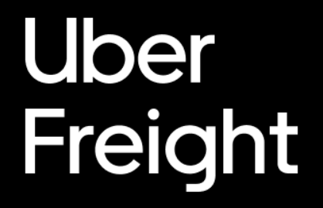


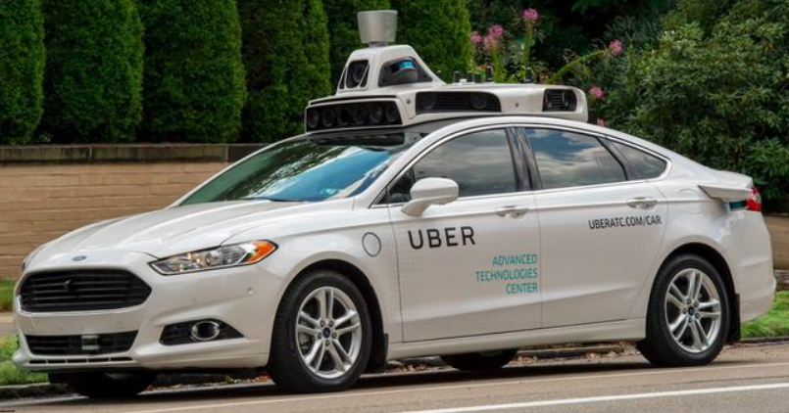

Innovation using Data Science at UBER
Data science plays a key role in guiding innovation and strategy
Reflected by hiring and experiment management policies
2.4% of employees are data scientists, many with doctoral degrees
Marketplace Change Protocol (MCP) for scheduling major experiments
Data-driven decision making in product development and operations
Experiments play a key role in how Uber makes decisions
Every product making team has Data Scientists in it
No Product last for more than 18 months without any update or innovation in Uber where Data Scientists play an important role
Some important products developed are below:
Notes:
Data science plays a key role in guiding innovation and strategy at Uber. This is reflected in Uber’s hiring and experiment management policies. Around 2.4% of employees are data scientists, a relatively high number compared to Lyft’s 0.9% and Amazon’s 0.5%. Many of these data scientists hold PhD’s, implying that Uber wants people both more than competent in data science but also at the cutting-edge of research and innovation. This is a significant investment into the belief that data science is the way forward for Uber.
To deal with problem of experiment contamination and spill-over effects, Uber introduced a new policy – the Marketplace Change Protocol – where teams who want to run a major experiment have to present it in front of head of engineering & head of product, who then make a decision on which experiments go through. In addition, cities undergoing major experiments have a moratorium on any other significant changes, ensuring a higher level of quality and validity for Uber’s data. This speaks to a culture of understanding the importance of data science and what it takes to empower data science teams. We can see this in our case: Stock has the option to prevent a change that may have significant impact on revenue and customer satisfaction in order to keep data clean and valid.
Data-driven decision making in product development and operations: when making decisions regarding the launch of new products, changes to existing products or simply monitoring their performance Uber relies heavily on data science. Different tests and experiments are conducted to monitor performance and key metrics: decisions are made with a heavy reliance on quantitative analysis.

Slide 4
Experiment to Make Decisions
User level A/B: used to compare and understand the effects of changes made to the platform on user behavior
Pros: Easy to set up. Can test effects of changes in UI/UX. Minimal contamination effect.
Cons: Focused on user level, not product.
Switchbacks: used to evaluate effects of product changes on an outcome variable.
Pros: Easy to set up. Can quickly evaluate effects of product changes.
Cons: Cannot analyze day-level effects. Prone to contamination. Only targets one outcome variable.
Synthetic control experiments: simulate controlled experiment to study effects of product change on a set of outcome variables
Pros: Can get precise and valid results for effect of product changes on more than one outcome variable.
Cons: Require significant changes to be detectable. More expensive to set up, take up more time and space.
Notes:
Experiments allow Uber to base their decisions on reliable data and valid quantitative analysis. They ensure that surprises are limited when a decision is made regarding a new product launch or changes to existing products.
Different kinds of experiments and tests are made in order to cover for the weaknesses of each specific experiment. For example, when testing their new algorithm for POOL Express, Uber ran shadow experiments using historical data to optimize their pickup locations. Once, the product was more advanced, they moved on the simulated live trials by cloning real-time POOL data and applying it to the Express algorithm. However, these tests couldn’t reveal rider feelings and sensitivity towards prices and wait times; so Uber distributed conjoint surveys to customers to collect primary data.
3 different kinds of major experiments:
User-level A/B: used to compare and understand the effects of changes made to the platform on user behavior
Pros: very easy to set up, allowing teams to quickly test effect of user-level changes like tweaks in the platform UI/UX. Minimal contamination effect, so will not interfere with product-level data. Can test more than 2 changes.
Cons: Cannot test new products since A/B experiments are focused on user level. Not scalable considering Uber’s size of operations since each demographic group needs its own set of tests.
Switchbacks: used to evaluate effects of product changes on an outcome variable. Involves splitting each day of the week into an odd number of treatments and controlling set of hours to test effects, usually over 2 weeks.
Pros: can quickly evaluate effects of product-wide changes, easy to set up. Shorter time duration than synthetic control experiments
Cons: designed around finding aggregate effect of changes over time, less focused towards analyzing day-level effects. Cannot test more than one change. Prone to contamination, so only one per city. Only targets one outcome variable, that combined with short time means it’s a way of quickly getting targeted results.
Synthetic control experiments: simulate lab-type experiment by assigning control and treatment cities, study effects of a product tweak on a set of outcome variables of interest.
Pros: allow Uber to get exact and valid results for product changes and their effect on more than one outcome variable, meaning you can get a complete understanding of marketplace dynamics
Cons: require any changes to be significant, more than 5%, to be detectable (so not assigned to random effect), but these experiments frequently create many less significant effects. More costly to set up (especially in terms of opportunity cost): take longer to run and require freeze on other changes

Slide 5
UBER Express Project
Why UBER Express since UBER Pool (2014) exists which is ride sharing service?
Ride-sharing may be the future of ride-hailing companies and should be innovated regularly
To make ride sharing efficient, eco-friendly and profitable as it was making loss
Reduce loops/detours and improve match efficiency which leads to good ratings of rider and drivers
Solutions/Uniqueness with Express:
Make riders wait and walk to the nearest pre-defined corners for pick-ups which will lead to less detours
Increase match efficiency (better rated drivers for riders and vise-versa), decrease costs per ride
More seat utilizations and more time for algorithms to optimize the route
Express algorithm was built with wait time of two and five minutes
Few Concerns:
Might be unsafe for riders to walk to pick up points (some routes might not be safe)
Weather and emergency cases will not be applicable under UBER Express
Not suitable for people with disabilities and Express limits privacy
Real connection between drivers and Uber is missing which might lead to trust issues
Notes:
Why does UBER Express since UBER Pool (2014) exist which is ride sharing service?
Ridesharing may be the future of ride-hailing companies and should be innovated regularly
To make ride sharing efficient, eco-friendly, and profitable as it was making loss
Reduce loops/detours and improve match efficiency which leads to good ratings of rider and drivers
Solutions/Uniqueness with Express:
Make riders wait and walk to the nearest pre-defined corners for pickups which will lead to fewer detours.
Increase match efficiency (better rated drivers for riders and vice versa), decrease costs per ride
More seat utilizations and more time for algorithms to optimize the route
Express algorithm was built with a wait of two and five minutes
Few Concerns:
It might be unsafe for riders to walk to pick up points (some routes might not be safe)
Weather and emergency cases will not be applicable under UBER Express
Not suitable for people with disabilities and Express limits privacy
Real connection between drivers and Uber is missing which might lead to trust issues

Slide 6

Identification of a Problem
How long should I wait?
2 mins / 5 mins .. ???
Notes:
High-level executives at Uber believe ride-sharing is the future of the platform, and of the ride-hailing industry in general. Ride-sharing means carpooling, so a reduction in carbon emissions as well as lower costs for both riders and Uber. The first Uber product targeting ride-sharing was Uber POOL, launched in 2014. It saw success in terms of adoption rate, with some markets seeing a higher growth in POOL than UberX
BUT are some problems. POOL is a home pickup service, so drivers must make loops and detours to pick up every rider. Riders don’t like that and would prefer a faster, more direct service. Home pickup also means less matches, so around half of POOL trips were unmatched -> they became regular UberX rides which are significantly less efficient in terms of cost per ride. POOL was therefore unprofitable 2 years after launch.
A potential solution was found in the form of Uber POOL Express by targeting the main problem with POOL: poor matching efficiency due to fixed individualized pickup points. Express offers riders less expensive rides in exchange for waiting an additional few minutes and then walking to a nearby pickup point. Waiting means the Express algorithm has more time to find a suitable match, and walking gives it more flexibility in how it makes matches. The problem Uber faces is with the waiting time: how long is too long? There is an efficiency vs experience tradeoff which must be balanced.
Uber has chosen to do so with a switchback experiment in Boston, where wait time alternated between 2 mins and 5 mins several times a day for 2 weeks.

Slide 7
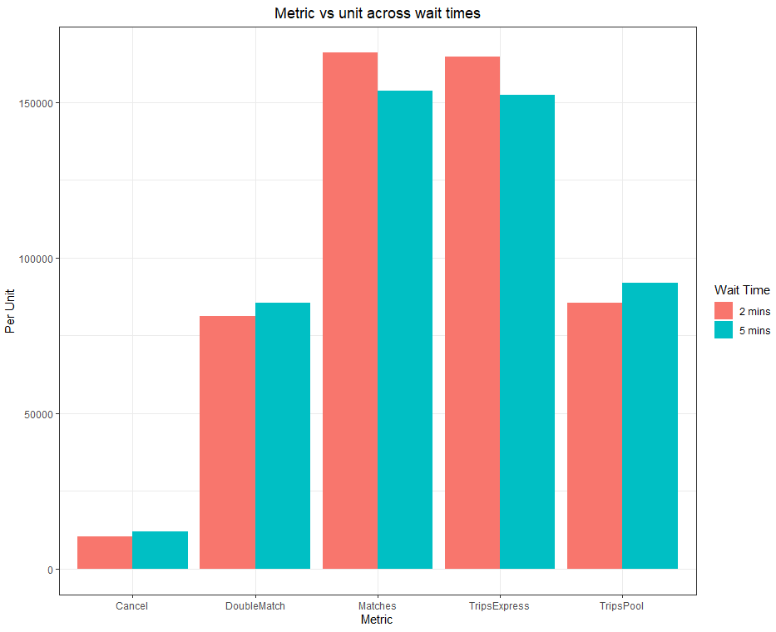
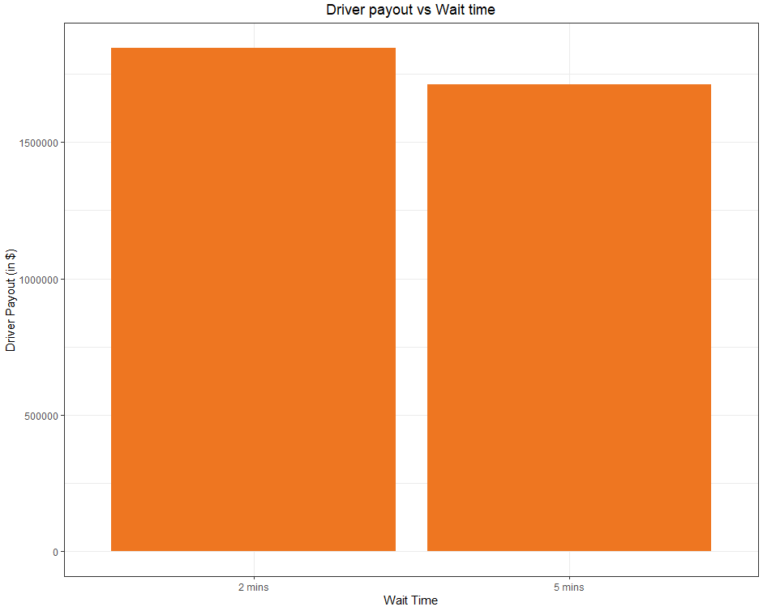
Insights on Experiment
Driver’s revenue with wait times
Cancelations, Match frequency, Pool/Express rides with two- and five-minutes wait time
Notes:
Having wait time of 5 minutes get more double match, cancellations and Pool trips compared with 2 minutes wait time. @ minutes gives more single match for a companion of a rider and more express trip.
Drivers earns mire with 2 minutes wait vs 5 minutes wait in Boston city.

Slide 8
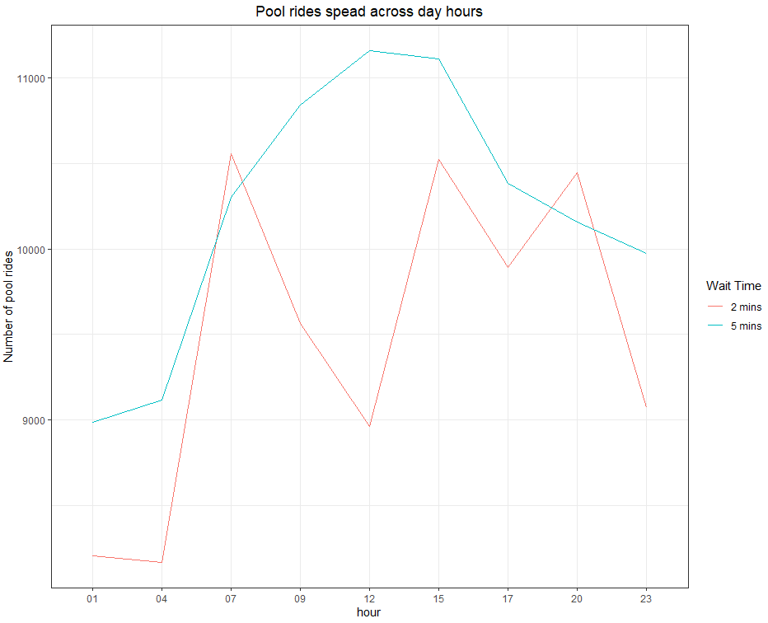
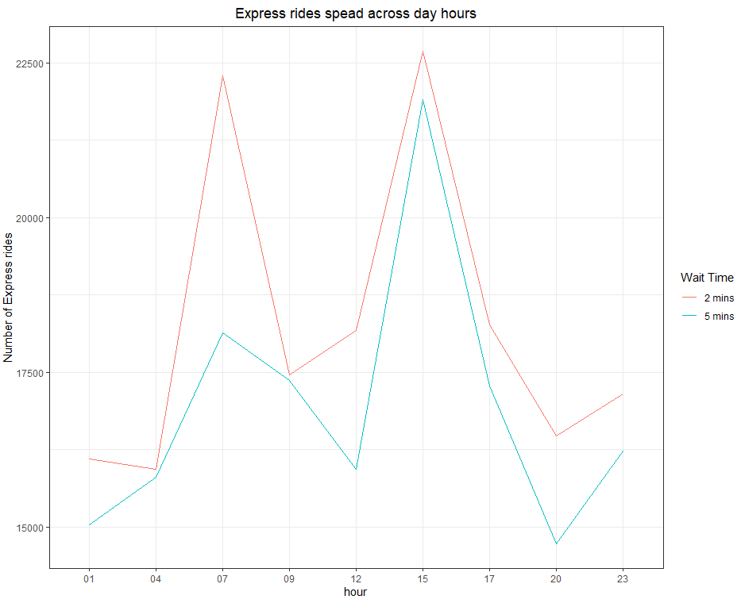
Insights on Experiment (Continued)
Pool rides across day hours
Express pool rides across day hours
Notes:
More wait time was favorable for 5 minutes wait time during nonpeak ours as customers prefer less wait time during peak time when they intend to go to work or start or end their day by traveling back to home or going to any other relevant activities/work.
Express rides are more for 2 minutes wait time compared to 5 minutes in the current result from experiment done on city of Boston.

Slide 9
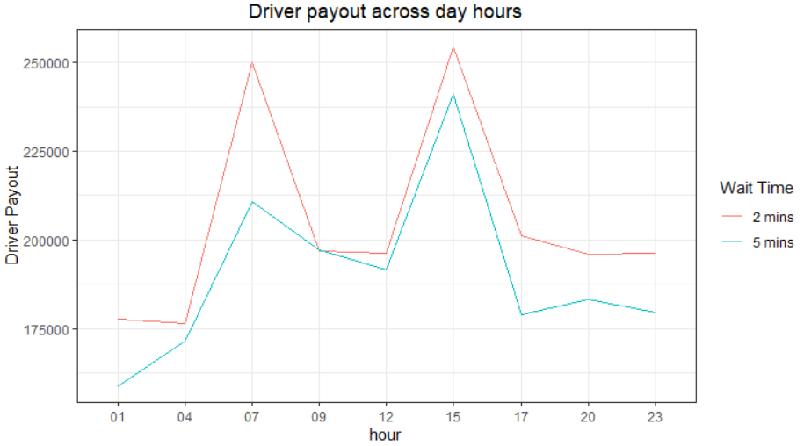
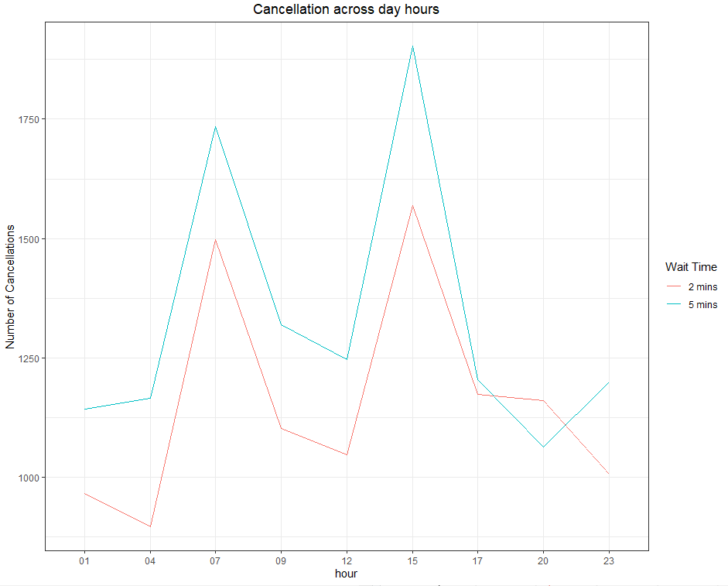
Insights on Experiment (Continued)
Drivers' payout pattern during day
Cancellations pattern during day hours
Notes:
Driver has more income in lesser wait time and have more cancellation by having 5 minutes wait time.

Slide 10
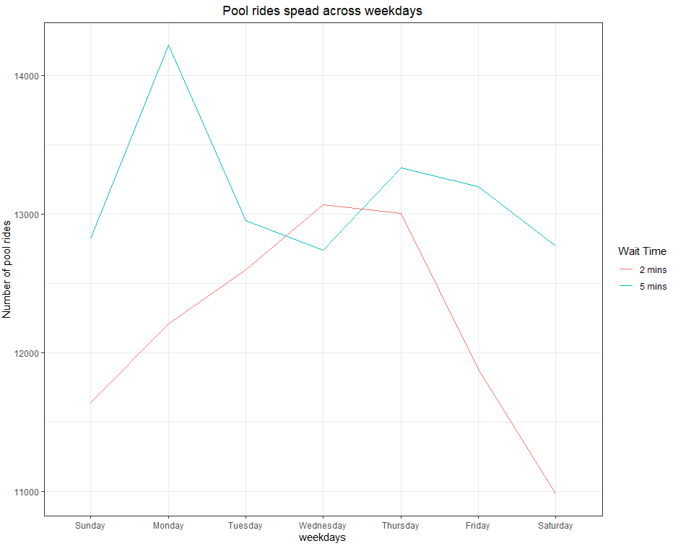
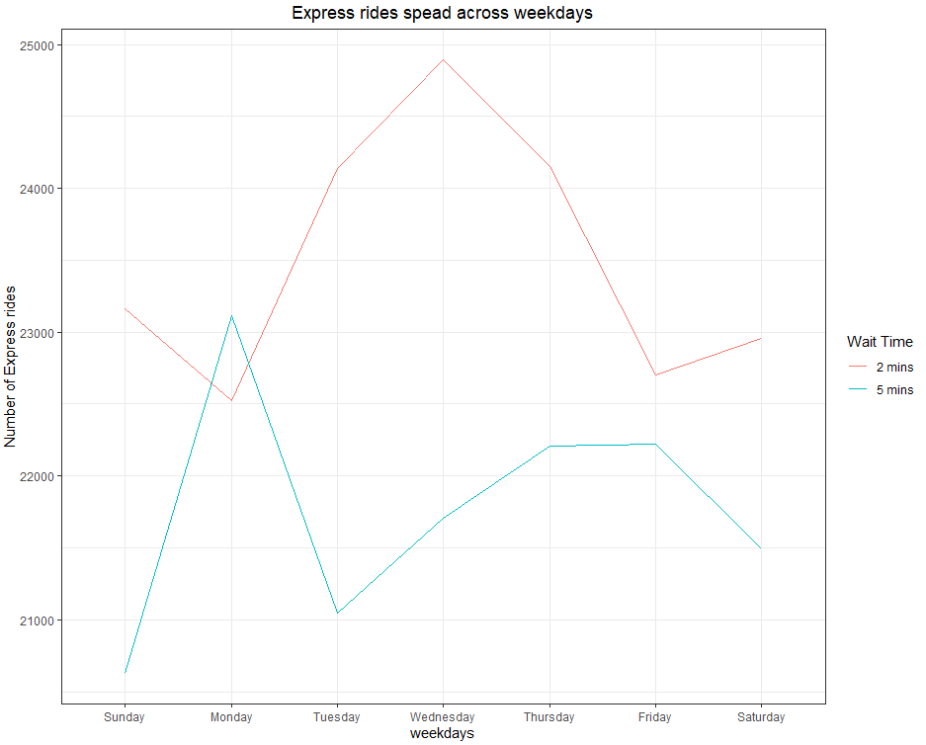
Insights on Experiment (Continued)
Pool ride traffic during weekday
Express ride traffic during weekday
Notes:
Uber Pool has more wait time compared to Express which says people waited for Pool then for Express in City of Boston

Slide 11
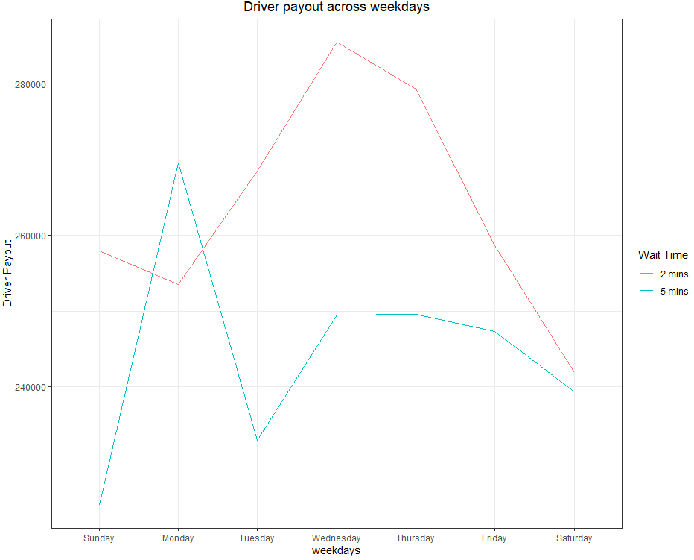
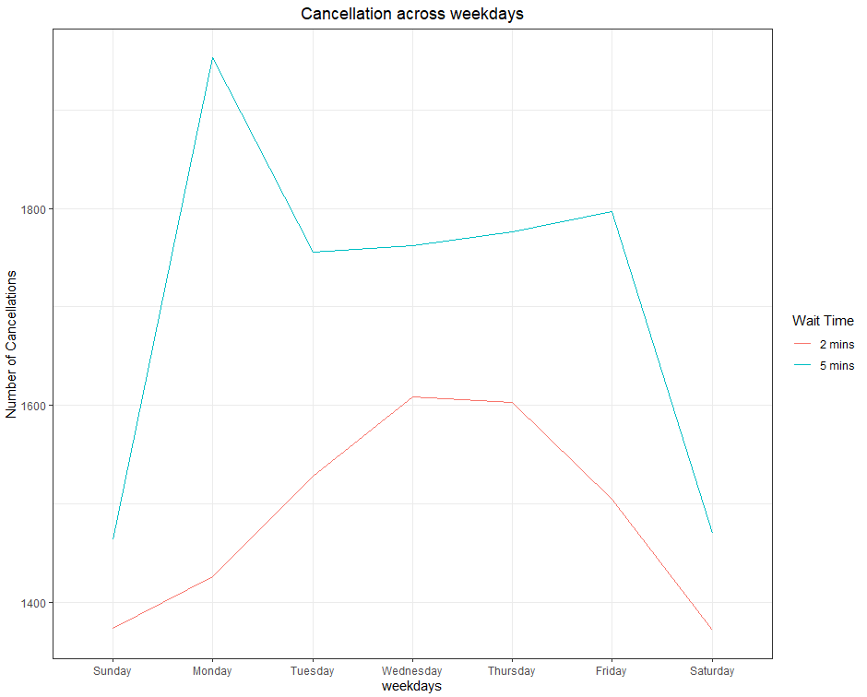
Insights on Experiment (Continued)
Driver’s Payout across weekdays
Cancellations pattern across weekdays
Notes:
Driver’s payout varies across weekdays for Pool and Express rides. In most of the day's driver earned more with less wait time and had more cancellation in case of higher wait time for customers.

Slide 12
Insights on Experiment (Continued)
Wait Time
Rush Hour
Wait Time and Rush Hour (combined)
2 Mins
5 Mins
2 Mins
5 Mins
2 Mins
5 Mins
Yes
No
Yes
Yes
No
No
95.83%
95.09%
94.37%
95.74%
95.10%
93.58%
96.01%
95.46%
Trip Acceptance
$7.70
$7.36
$8.16
$7.38
$8.23
$8.08
$7.57
$7.19
Avg. Earning (per trip)
2.40
2.42
2.74
2.33
2.70
2.79
2.32
2.33
Seat Fill Rate
Pool Rides Ratio
34.16%
37.64%
31.30%
37.01%
30.09%
32.59%
35.19%
38.85%
Express Rides Ratio
65.83%
62.35%
68.69%
62.98%
69.90%
67.40%
64.80%
61.14%
Notes:
Trip acceptance is (1 – (cancellation/Pool and Express trips))*100
Average Earning per trip is payout/ (pool + express rides - cancellations)
Seat fill rate is ((total matches * 2)+(double matches * 3))/ (pool + express rides - cancellations)
Pool ratio is pool trip/ (pool + express trip)
Express ratio is express trip/ (pool + express trip)

Slide 13
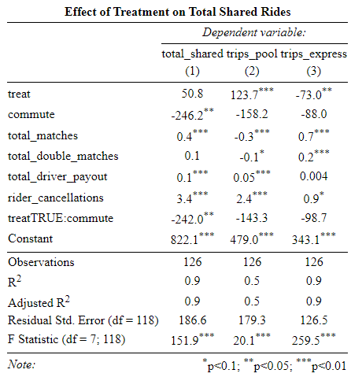
Efficiency vs Experience
How does increasing wait time affect Uber’s ride-sharing products?
Rush hours: from 7 – 9:40 AM and 3 – 5:40 PM
Outside rush hours: increased wait time has no effect?
During rush hours: negative effect on total trips, but is it the waiting or the rush?
Closer look at product dynamics
Substitution between POOL and Express
Will Uber lose money by increasing wait times?
Notes:
We looked at the effect of increasing wait time on the total number of shared rides. Does increasing wait time make riders prefer to use single-user product like UberX?
Total shared rides defined as sum of trips made with POOL and with Express.
Ran a linear regression with an interaction term between the treatment (increasing wait time) and the commute variable, indicates if rush hour or not
The figure to the right shows the output of three regressions. The first shows the effect of treatment and rush hours on total shared rides trips. At first glance it seems that waiting more has no effect on total shared trips when outside of rush hours, and that during rush hours increasing wait time has a strong negative effect.
BUT the effect is almost the same as the one rush hours have without any increase in wait time, so cannot conclusively say that the negative effect is because riders are switching to a non-sharing product to get to and from work when faced with more wait time.
Closer look: 2 other regressions are for the total trips made with POOL and with Express
Outside of rush hours, increasing wait time results in decrease in trips made with Express and increase of trips made with POOL. From this we can assume that riders are substituting from Express to POOL because they are more sensitive to the increased wait time than to the lower price. Inside of rush hours there does not appear to be a significant effect. If we are right in assuming the decrease in shared ride usage is due to the rush hour effect and not the increase in wait time, then we could claim that increased wait time during rush hours has no effect on total shared rides.
This may be because people are more sensitive to price during rush hour trips since those are relatively more expensive due to higher demand (surge pricing), and so are less affected by an additional 3 minute wait.
Can also see a correlation between the number of shared rides and the number of rider cancellations

Slide 14
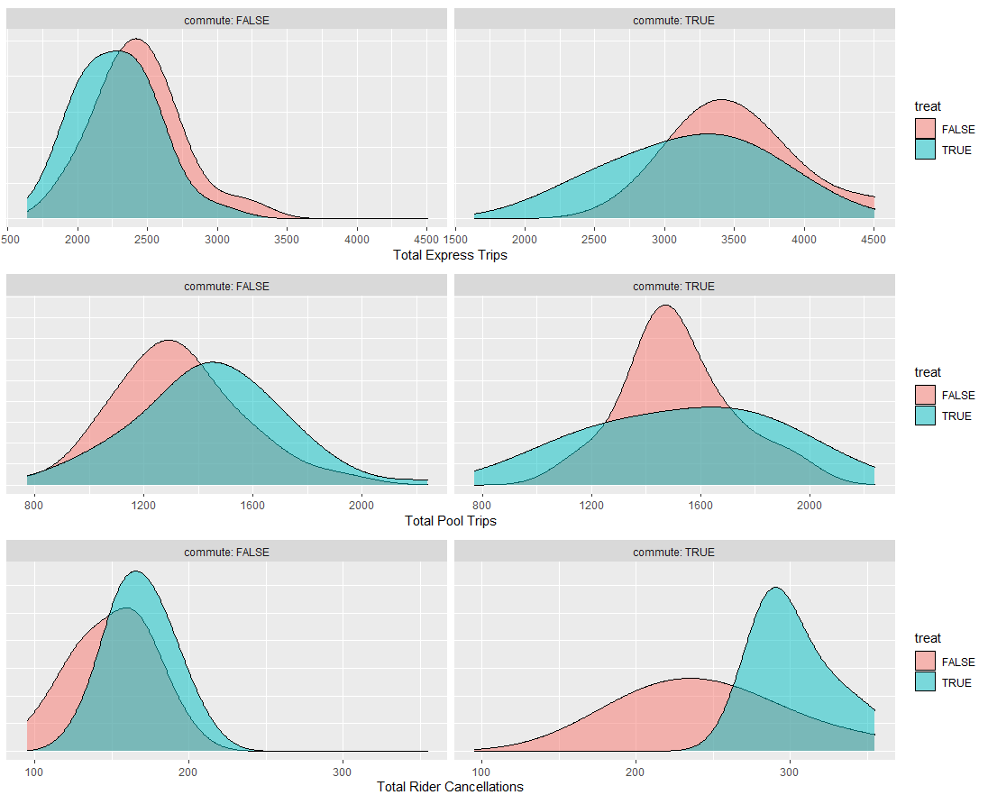
Efficiency vs Experience
Density plots show the substitution effect between Uber Express and Uber Pool during rush hours.
Increasing waiting time leads to a negative customers experience, which may be reflected by a significant increase in riders' cancellations during rush hours.
Notes:
Density plots show this substitution effect: when increasing wait time relatively more people use Uber POOL as opposed to Express, regardless of whether riders are travelling during peak hours or not.
We can also see that additional wait time has a negative effect on rider cancellations, with more people cancelling when they have to wait longer

Slide 15
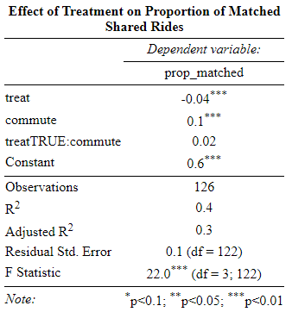
Efficiency vs Experience
Increased wait time means relatively less matched trips outside of rush hours
Rush hours increase proportion of matched trips
Increased wait has no effect during rush hours
Notes:
Regression was also run on the proportion of matched shared rides, so how many rides were successfully matched. See that outside of rush hours increasing wait time decreases the relative number of matched rides => may be because of the substitution effect, where more Uber POOL rides = less matching due to less efficient process.
Rush hours has a positive effect on matching efficiency, and increasing wait time during these hours seemingly has no effect.

Slide 16
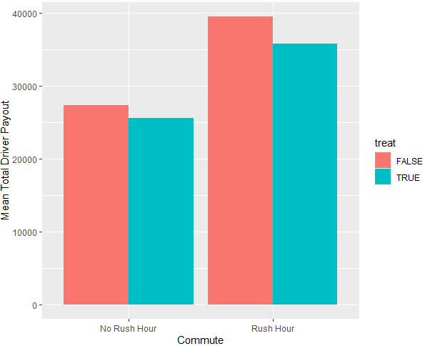
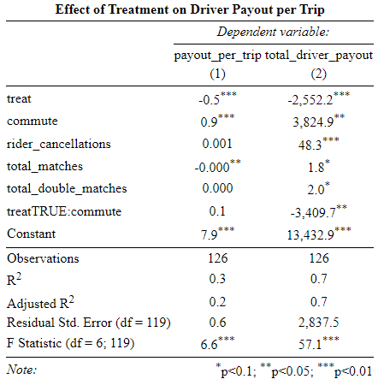
Efficiency vs Experience
Uber’s costs are equal to driver payouts
Outside of rush hours, more waiting means less costs
Despite substitution towards POOL
Rush hours heavily increase Uber’s costs
Despite increase in matching efficiency
More efficiency during rush means larger cost reduction
Notes:
We ran two regressions to check the effects of treatment on Uber’s costs, which are the same as driver payouts.
One regression used payout per trip as dependent variable, and the other used total driver payout.
Both regressions show that increasing wait times outside of rush hours decreases Uber’s costs.
Both regressions also show that rush hours increase Uber’s costs.
The regression for total driver payout, which has a higher R-squared than the payout per trip model and is therefore better suited to showing causal effects, shows that increasing wait time during rush hours decreases Uber’s costs by more than outside of rush hours. In fact, this decrease is larger than it seems: the cost increase generated by rush hour conditions is more than offset by the decrease due to better matching efficiency, resulting in a net decrease in costs

Slide 17
Recommendations
Increase Uber POOL Express wait time to 5 mins only during rush hours
Rush hour conditions makes an increased wait time bearable for riders
Strong sensitivity to price
Strategy will generate additional revenue for Uber…
While preventing substitution towards POOL
Greater usage and adoption for Express
Faster market maturation
Notes:
Leads us to our recommendation: increasing waiting time from 2 to 5 minutes, but only during rush hour
Could assume that riders would want to get home faster, but turns out are more sensitive to cost decrease
Increasing wait time will damage validity of synthetic control experiment data, but will yield greater revenue for Uber
Most importantly, riders will be less likely to want to substitute towards Uber POOL, which means a greater amount of usage of the Express product and a greater acceptance of having to walk and wait in exchange for lower prices.
Adoption will grow, which will make city markets mature faster, and so over time we can expect to see less substitution and a greater willingness to wait 3 more minutes in order to pay less.

Slide 18
Thank You!
Floor open for Questions!

